Slide 1
#HeyBlue
Full project Overview

Slide 2
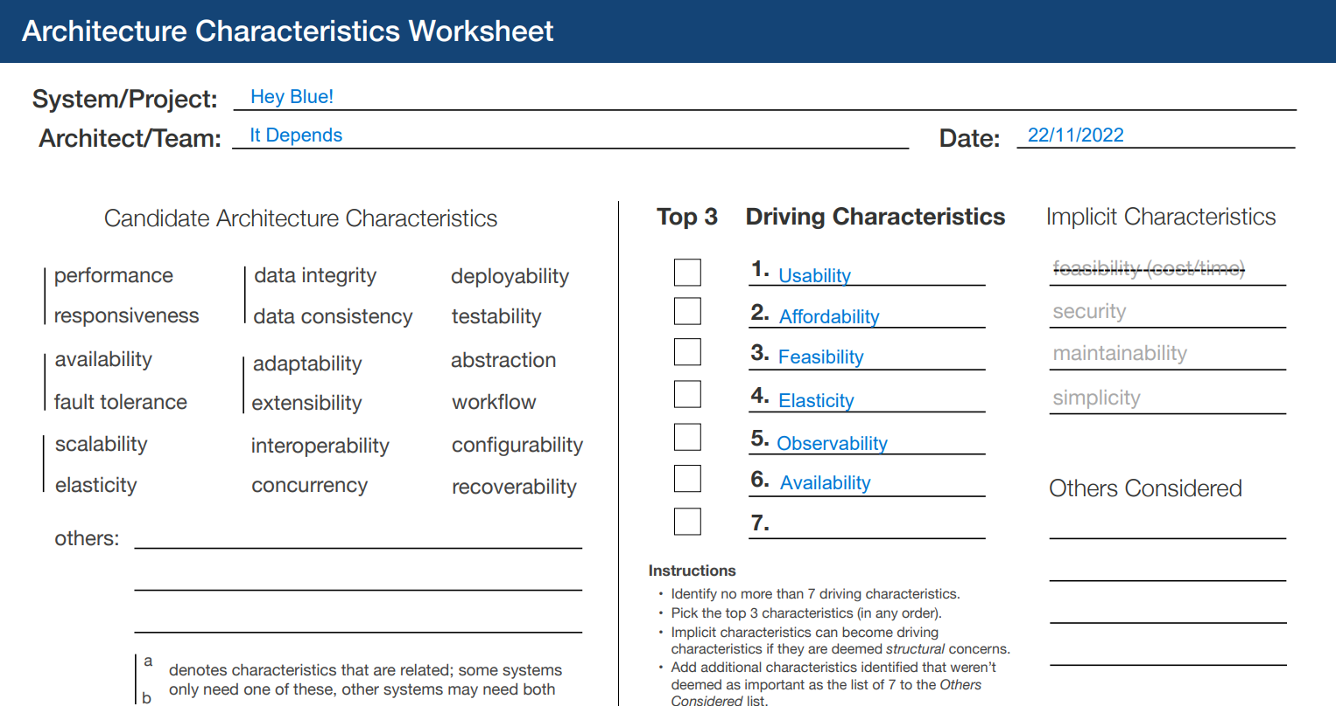
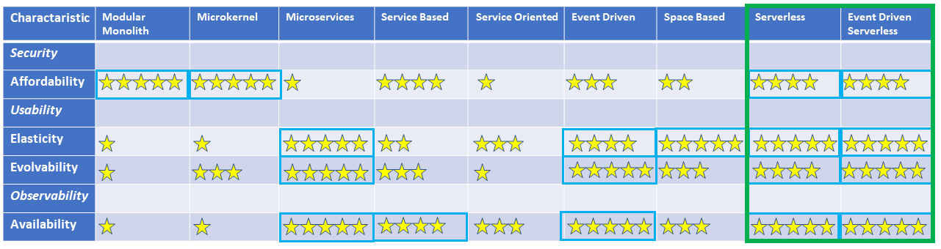
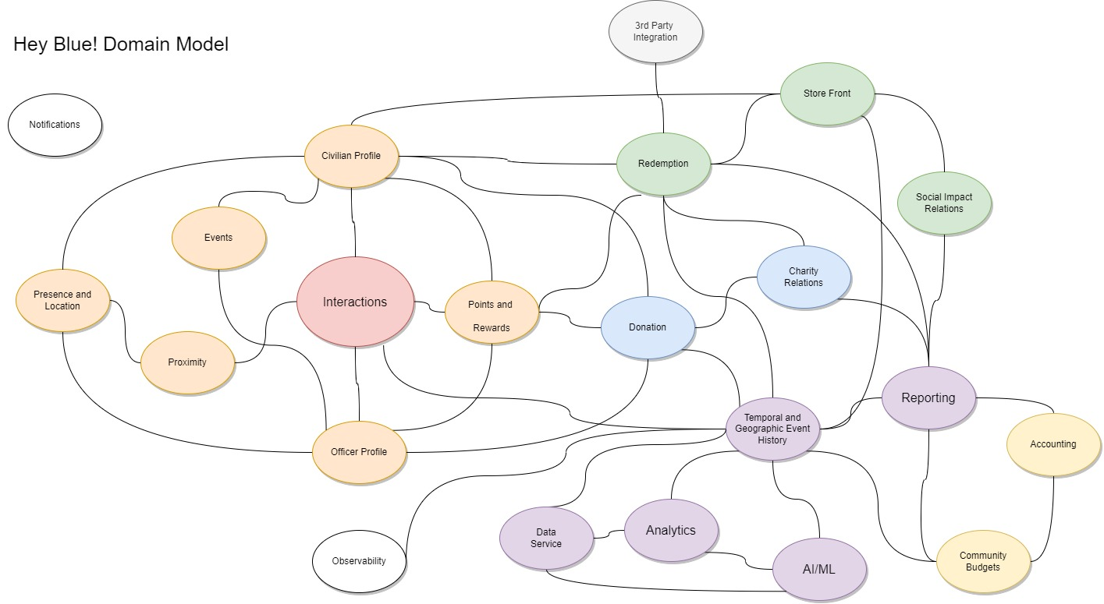

Slide 3
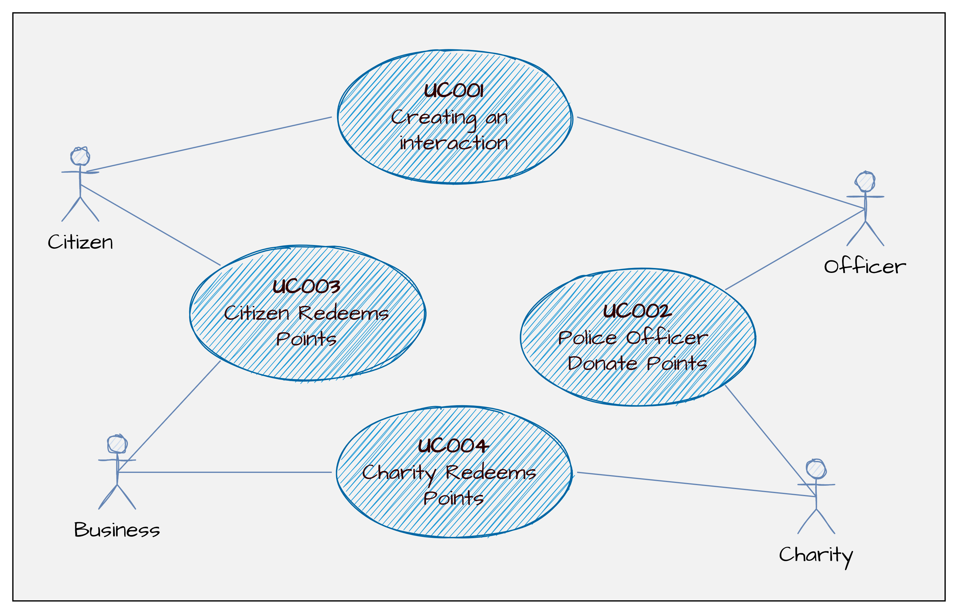


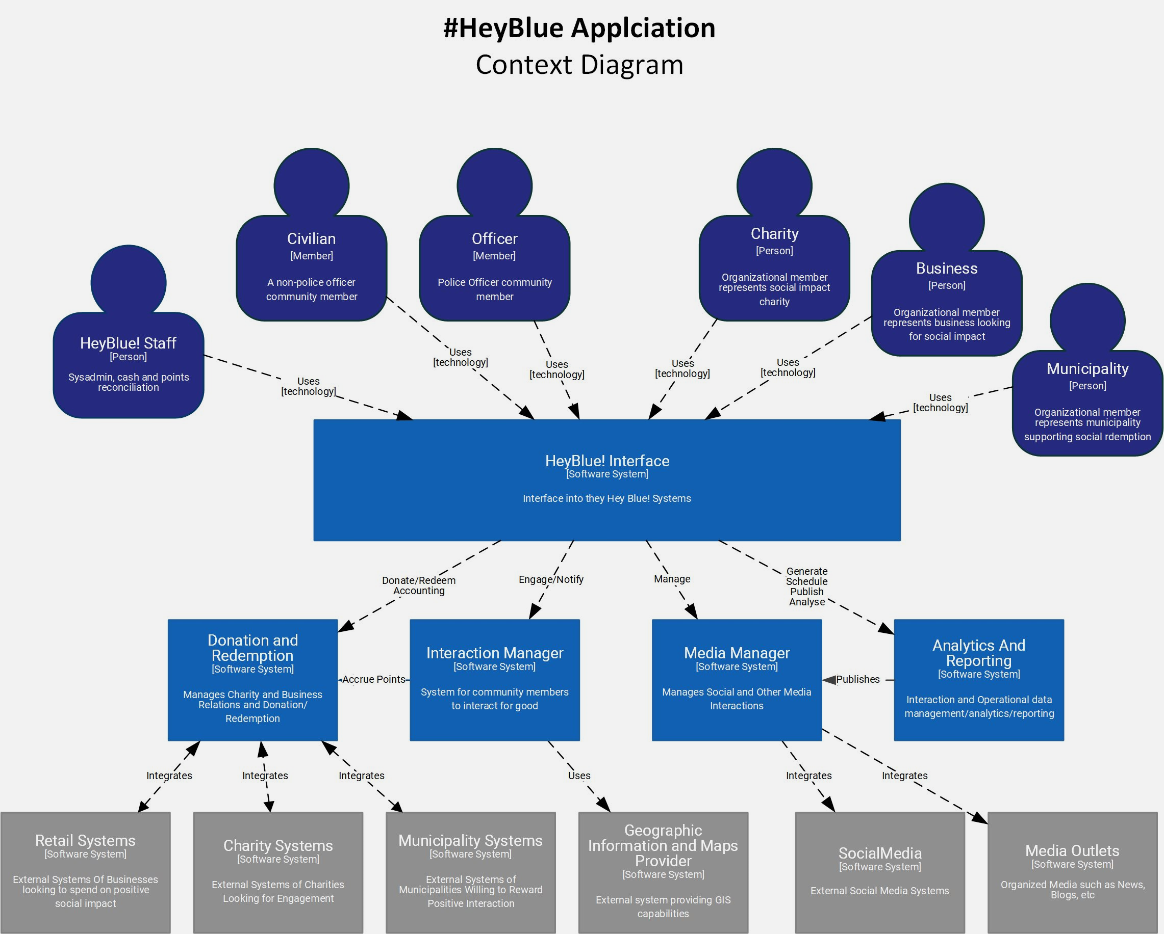

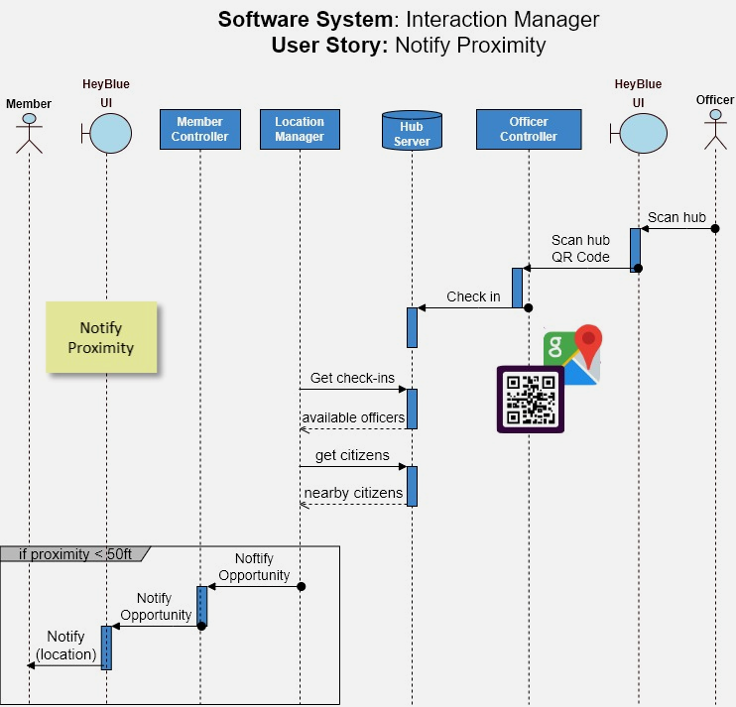
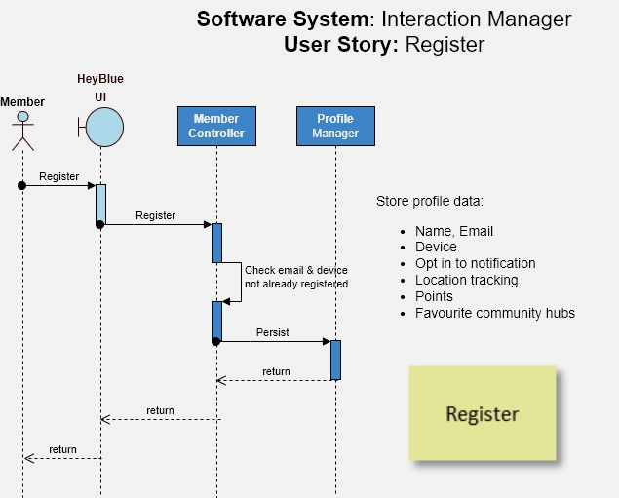
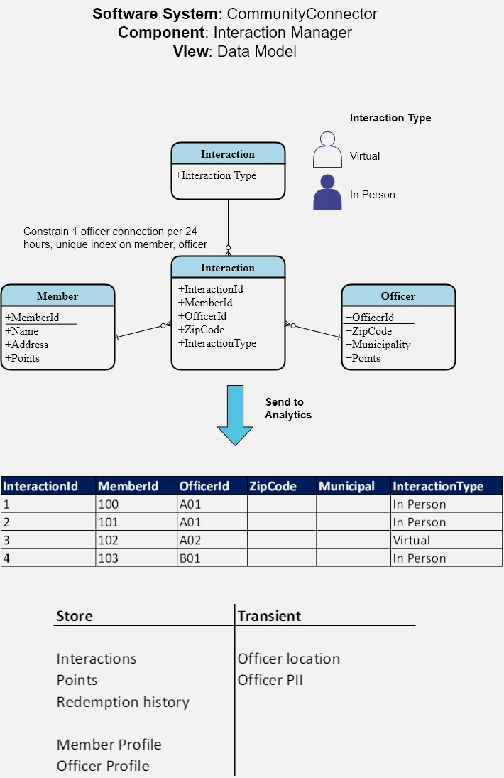
Connect the dots
SR-IM-007 Community members find the officers that are willing to connect
SR-IM-007
ADR on Security
ADR on System Design
Straight
through
architecture

Slide 4
#HeyBlue! Requirements User Story Map
Interact
Media
Donate & Redeem
Analytics
E-Commerce
Register
Notify
Proximity
Interact
Earn Points
Share
Browse store
Redeem Points in store
Browse Charities
Donate points to charity
Send to analytics
Register
Create profile for Citizen
Location Tracking
Proximity Alert
Calculate Rewards
Share to #HeyBlue feed
Retailer creates storefront
Spend management
Charity Registers
Send to charity
Store metrics
Business storefront
Create profile for Officer
Option to connect
Add rewards to profile
Share to Social Media
Update points
Present metrics
Charity front page
Update profile
Get Map
Purchase Items
Delete profile
Legend
Activities
User Stories
Task
Must have

Slide 5
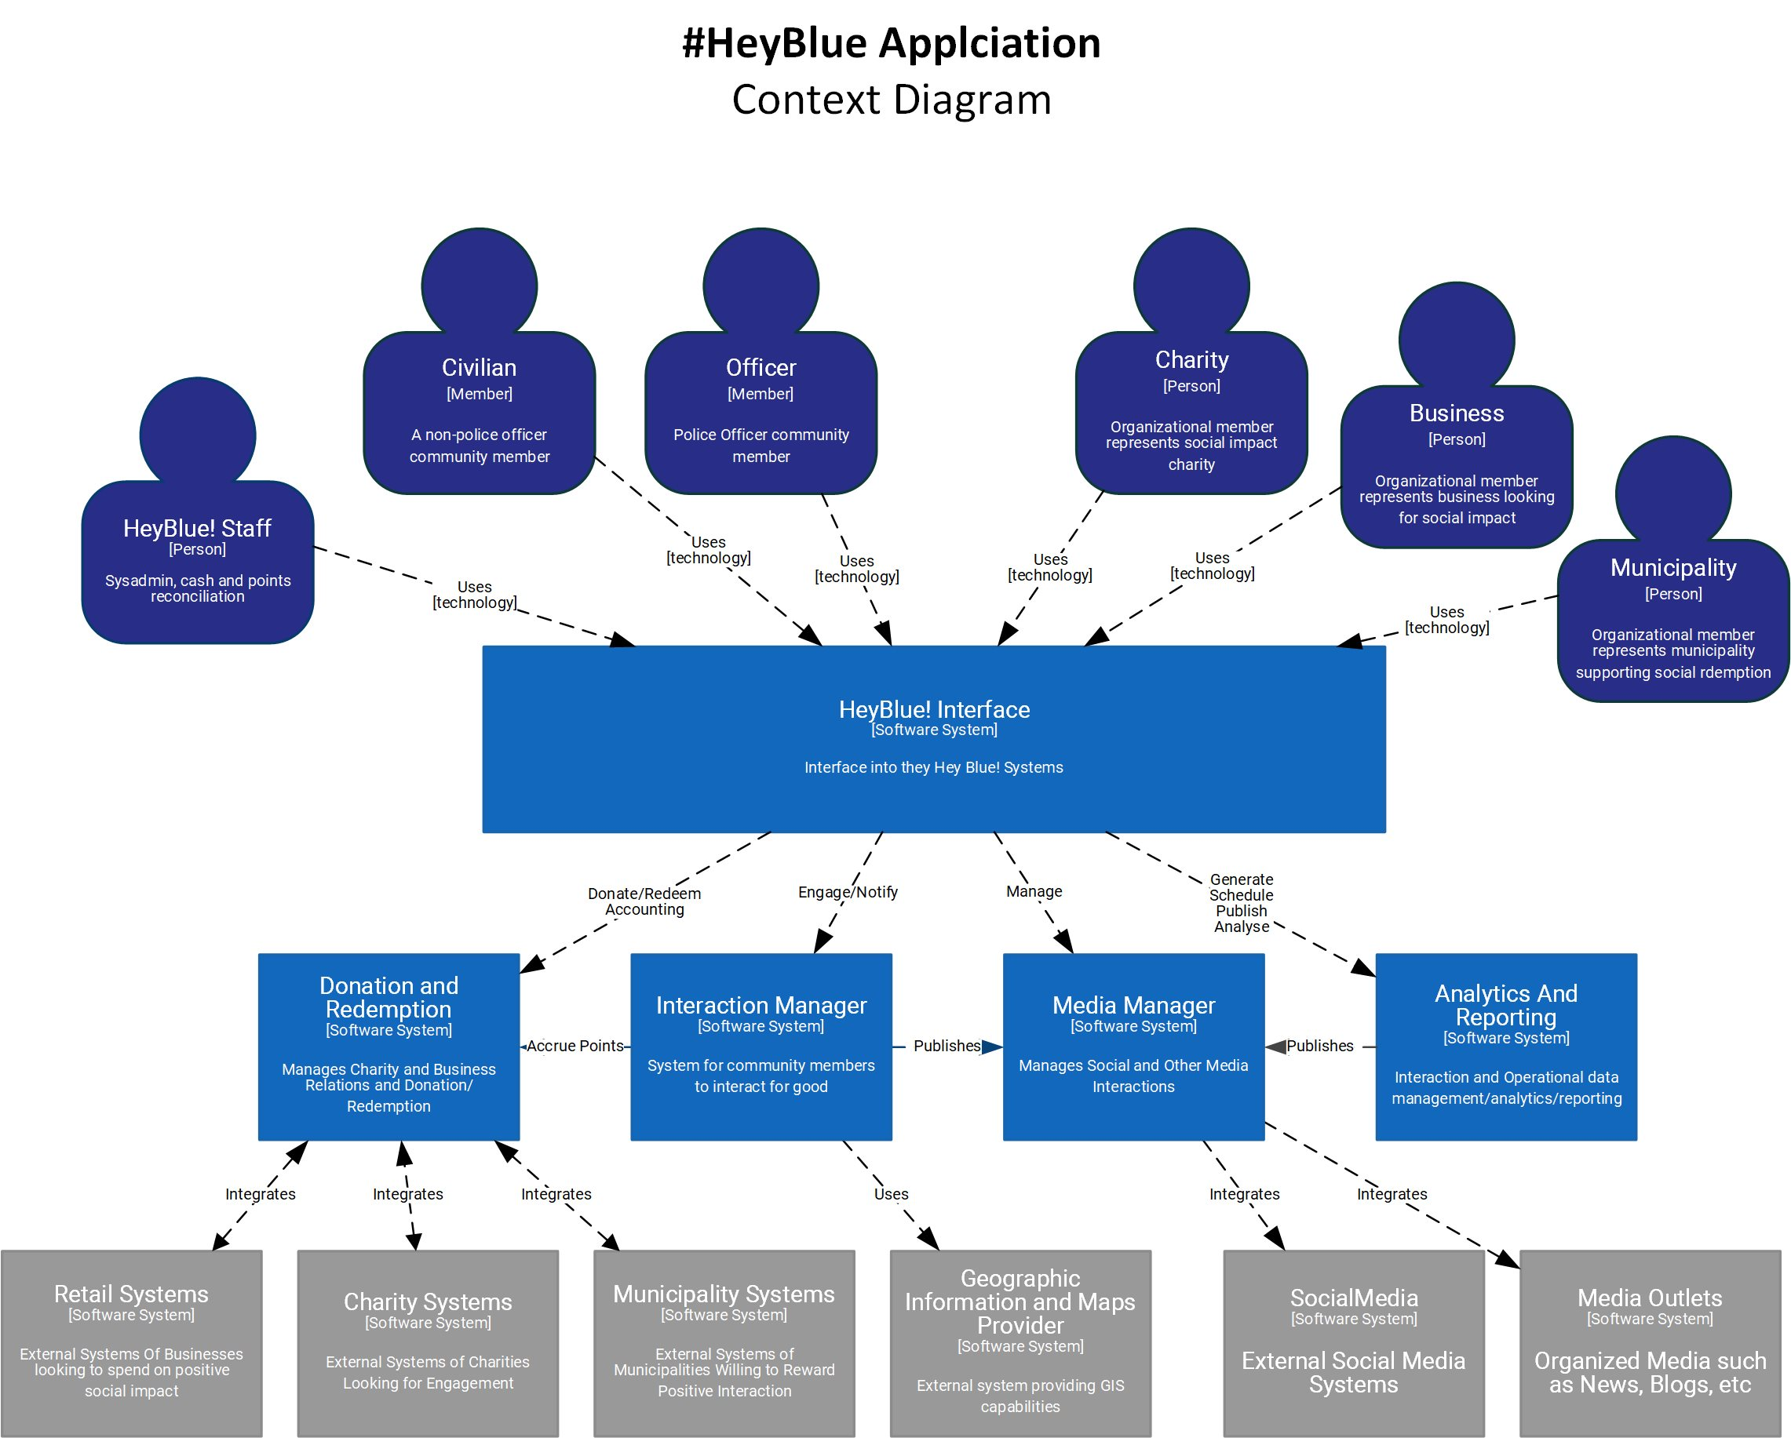
#HeyBlue! Solution
Context Diagram

Slide 6
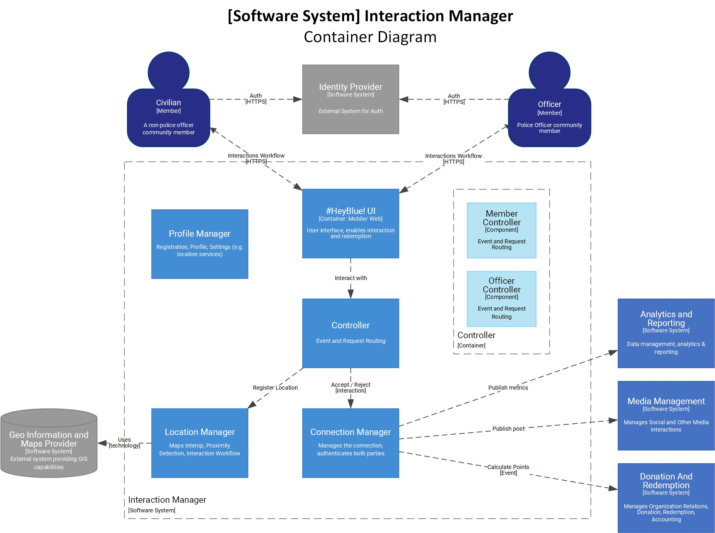
#HeyBlue! Solution → Interaction Manager Software System Container Diagram

Slide 7
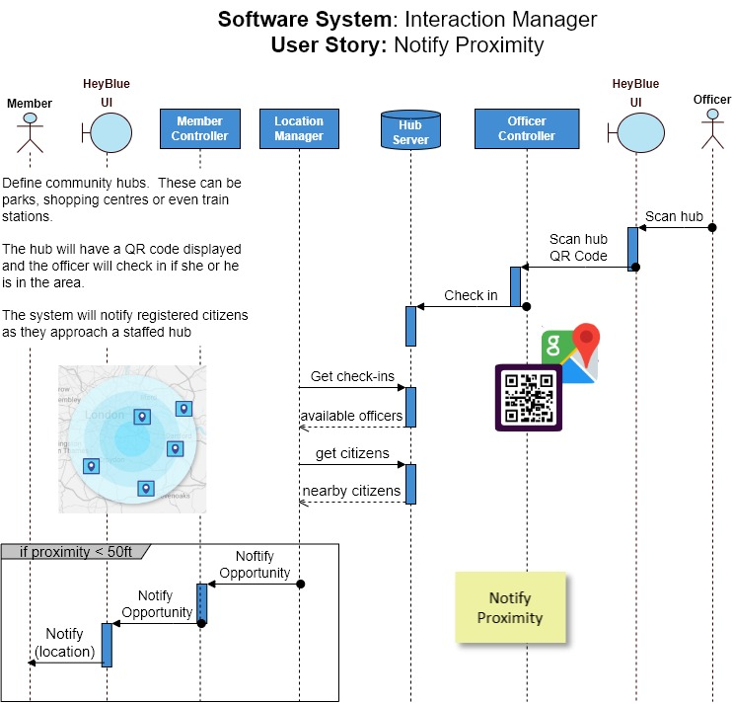
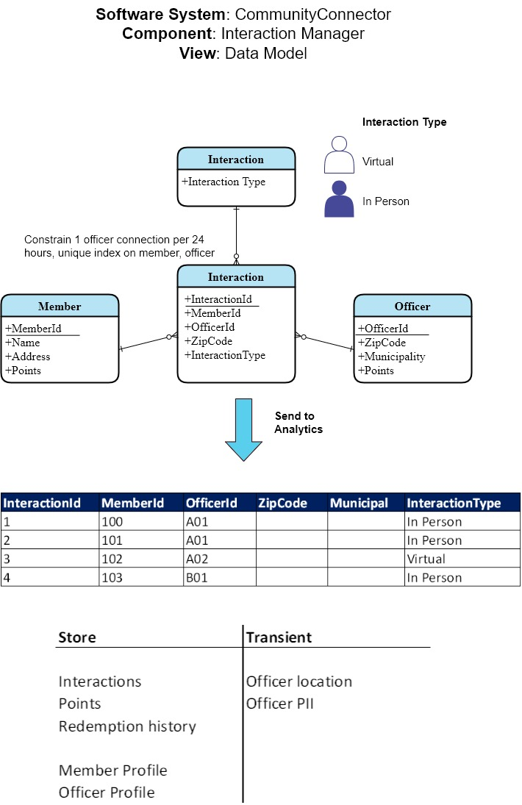
#HeyBlue! Solution → Interaction Manager Detailed Design and
Architecture Decision Record(s)

